Slide 1
Aisle Find It
Group 16
Members:
Andy Hecht
Jamsheed Yazdani

Slide 2
Target Audience
Party Goers
Travelers
Young Adults
Anyone in a hurry or in a new area

Slide 3
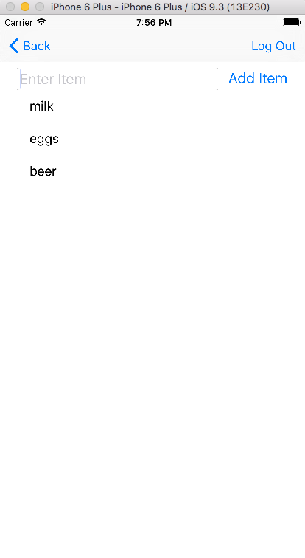
Purpose of Application
Create and edit grocery lists
Keep a running list of items you need each week
Add and delete items at any time

Slide 4
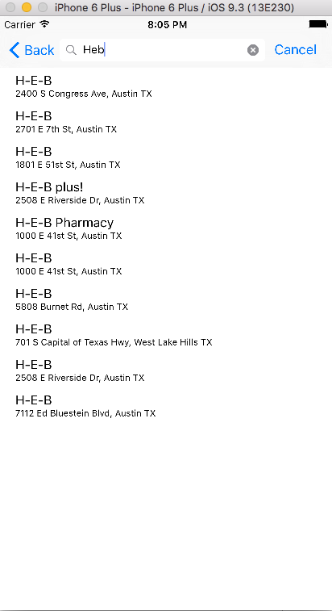
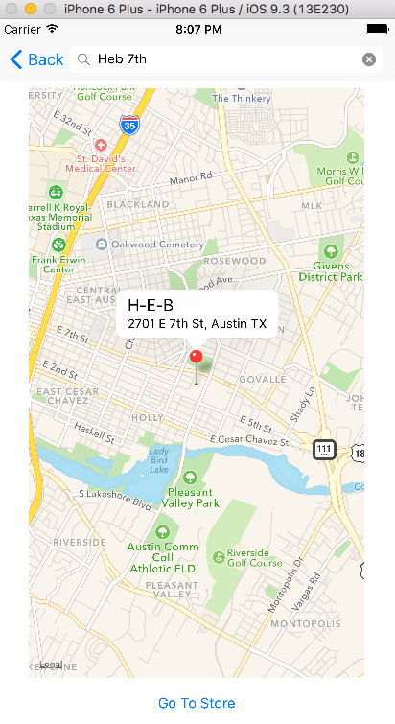
Purpose of Application
Find nearby grocery store
Search for your favorite grocery stores
You can even search for stores you hate if you really want

Slide 5
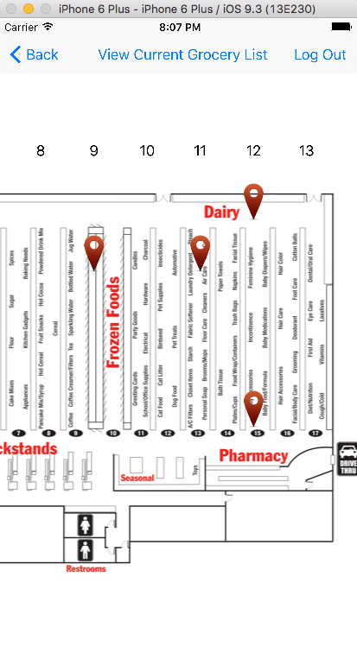
Purpose of Application
Find location of items in a grocery store
AisleFindIt will create pins marking where each item is located within your given store
Delete items off your list as you collect them

Slide 6

Demo Time
Feel free to ask questions during our presentation

